Slide 1
What if Data Are Not Perfectly Linearly Separable?
Cannot find w and b that satisfy
y_{i} (<w,x_{i}> + b) ≥ 1 for all i
Introduce slack variables ξ_{i}
y_{i} (<w,x_{i}> + b) ≥ 1 - ξ_{i} for all i
Minimize
|w|² + C Σ ξ_{i}

Slide 2
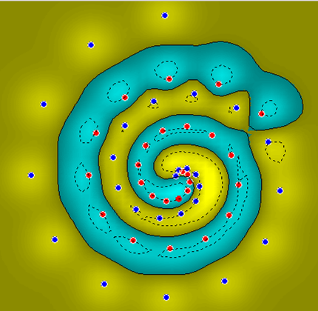
What if Surface is Non-Linear?
O
O
O
O
O
O
O
O
O
O
X
O
X
X
O
X
O
X
X
O
O
O
O
O
O
O
Image from http://www.atrandomresearch.com/iclass/

Slide 3
Kernel Methods

Slide 4
When Linear Separators Fail
x₂
x₂
X
X
X
X
x₁
O
O
X
X
O
O
O
O
X
X
x₁
O
O
x₁

Slide 5
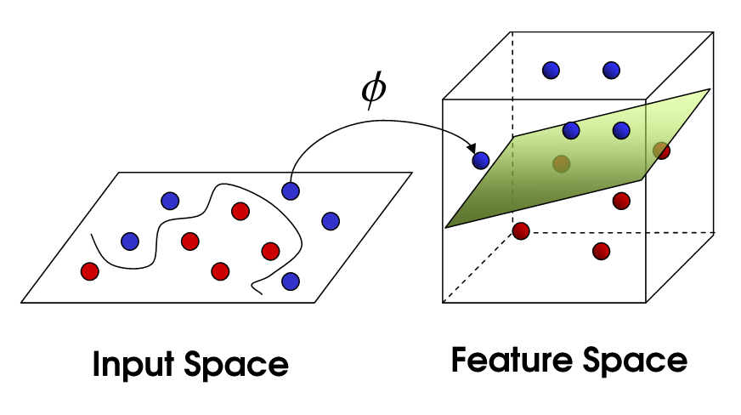
Mapping into a New Feature Space
Φ : x → X = Φ(x)
Φ(x₁,x₂) = (x₁,x₂,x₁²,x₂²,x₁x₂)
Rather than run SVM on x_{i}, run it on Φ(x_{i})
Find non-linear separator in input space
What if Φ(x_{i}) is really big?
Use kernels to compute it implicitly!
https://www.youtube.com/watch?v=3liCbRZPrZA
https://www.youtube.com/watch?v=_YPScrckx28

Slide 6
Kernels
Find kernel K such that
K(x₁,x₂) = < Φ(x₁), Φ(x₂)>
Computing K(x₁,x₂) should be efficient, much more so than computing Φ(x₁) and Φ(x₂)
Use K(x₁,x₂) in SVM algorithm rather than <x₁,x₂>
Remarkably, this is possible

Slide 7
The Polynomial Kernel
K(x₁,x₂) = < x₁, x₂ > ²
x₁ = (x₁₁, x₁₂)
x₂ = (x₂₁, x₂₂)
< x₁, x₂ > = (x₁₁x₂₁ + x₁₂x₂₂)
< x₁, x₂ > ² = (x₁₁² x₂₁² + x₁₂²x₂₂² + 2x₁₁ x₁₂ x₂₁ x₂₂)
Φ(x₁) = (x₁₁², x₁₂², √2x₁₁ x₁₂)
Φ(x₂) = (x₂₁², x₂₂², √2x₂₁ x₂₂)
K(x₁,x₂) = < Φ(x₁), Φ(x₂) >

Slide 8
Kernels
What does it mean to be a kernel?
K(x₁,x₂) = < Φ(x₁), Φ(x₂) > for some Φ
What does it take to be a kernel?
The Gram matrix G_{ij} = K(x_{i}, x_{j})
Positive definite matrix
Σ_{ij} c_{i} c_{j} G_{ij} ≥ 0 for c_{i,} c_{j} ∈ ℜ
Positive definite kernel
For all samples of size m, induces a positive definite Gram matrix

Slide 9
A Few Good Kernels
Dot product kernel
K(x₁,x₂) = < x₁,x₂ >
Polynomial kernel
K(x₁,x₂) = < x₁,x₂ >^{d} (Monomials of degree d)
K(x₁,x₂) = (< x₁,x₂ > + 1)^{d} (All monomials of degree 1,2,…,d)
Gaussian kernel
K(x₁,x₂) = exp(-| x₁-x₂ |²/2σ²)
Radial basis functions
Sigmoid kernel
K(x₁,x₂) = tanh(< x₁,x₂ > + ϑ)
Neural networks
Establishing “kernel-hood” from first principles is non-trivial

Slide 10
Overfitting

Slide 11
Overtraining/overfitting
A well known problem with machine learning methods is overtraining.
This means that we have learned the training data very well, but
we can not classify unseen examples correctly.
An example: A botanist really knows trees. Every time he sees a new tree,
he claims it is not a tree.
=-1
=+1

Slide 12
Overtraining/overfitting 2
A measure of the risk of overtraining with SVM (there are also other
measures).
It can be shown that: The portion, n, of unseen data that will be missclassified is bounded by:
n ≤ Number of support vectors / number of training examples
Ockham´s razor principle: Simpler system are better than more complex ones.
In SVM case: fewer support vectors mean a simpler representation of the hyperplane.
Example: Understanding a certain cancer if it can be described by one gene
is easier than if we have to describe it with 5000.
Notes:
Example with a gardener.

Slide 13
Training a SVM Model

Slide 14
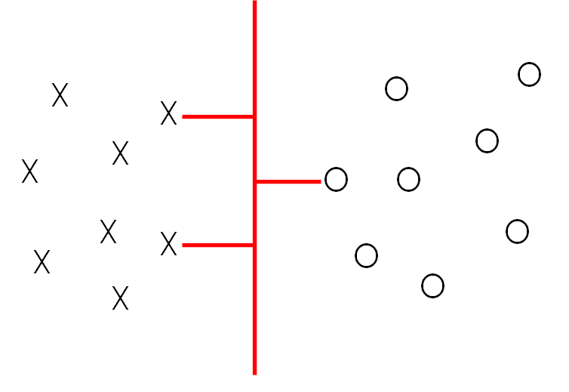
Features
In fact every X and O are a representation of an object in a group.
To represent an object in SVM, we get some characteristics of an object.
Every characteristic or variable is called a Feature.
Features should be nominal(digits) to be able to apply Mathematical algorithms such as SVM over them.
For example,
List of permissions in Android apps are the features.
Number of sides in a cube is a feature to represent cubes.
Cat ear size and the number of legs are the features for training a model to identify cats.
Attack_impact for every vulnerability can be a feature to identify high exploitable vulnerabilities.
You may need to clean the dataset to quantize the features.
For example, To quantize the permissions in Android apps, 1 represents the existence of a permission and 0 represents the non-existence of a permssions.
For Vulnerabilities, if Attack_impact is High, it can be map to 0, if it is Low it can map to 1.

Slide 15
Class
Every object(item) belong to a group(category) that is called Class in machine learning
There are usually two categories in ML class
For example, in the Android apps dataset, the class showing whether an object is benign or malware
There are datasets in that, objects categorize into more than two class that needs to utilize multi-class ML algorithms.

Slide 16
Clean the data
You need to clean the data in order to:
Quantize the feature’s value
Fill in the missing values
Delete the outlier
…
Details of data cleaning is provided in module 4

Slide 17
Split the data
To be able to evaluate the trained model, you need to keep a portion of the data for evaluation. This portion is referred to as the testing dataset.
The portion of the data for training the model is called the training dataset.
Usually the data split to ~ 30/70 for testing/training dataset.

Slide 18
class
Features
 | Permission1 | Permission2 | Permission3 | Permission4 | Permission5 | Malware/benign
app1 | 1 | 0 | 1 | 1 | 1 | 1
App2 | 0 | 0 | 0 | 1 | 0 | 0
App3 | 0 | 0 | 1 | 1 | 1 | 1
App4 | 1 | 0 | 1 | 1 | 1 | 1
App5 | 0 | 0 | 0 | 1 | 0 | 0
App6 | 0 | 0 | 1 | 1 | 1 | 1
App7 | 1 | 0 | 1 | 1 | 1 | 1
App8 | 0 | 0 | 0 | 1 | 0 | 0
App9 | 0 | 0 | 1 | 1 | 1 | 1
App10 | 1 | 1 | 1 | 1 | 1 | 1
Training set
Testing set

Slide 19
Steps for modeling
1- Select some variables as features
2- Clean data: quantize the features
3- Identify the variable as the Class of objects
4- Split the data into a testing/training dataset
5- Apply ML algorithms (e.g. SVM) to model based on the training dataset
6- Evaluate your model over the testing dataset.

Slide 20
SVM with Python

Slide 21
1- Import necessary libraries
import pandas as pd
from sklearn.model_selection import train_test_split
from sklearn.svm import SVC
from sklearn.metrics import precision_score, recall_score, accuracy_score, f1_score
List of metrics in sklearn: https://scikit-learn.org/stable/modules/model_evaluation.html

Slide 22
2- Identify features and class variables
# Split the data into features (X) and class y (malware/benign app)
X = app_df.iloc[:, 8:]
y = app_df['malware']

Slide 23
3- Split data to training and test set
# Split the data into training and testing sets
X_train, X_test, y_train, y_test = train_test_split(X, y, test_size=0.2, random_state=42)

Slide 24
4- Model
# Create an SVM classifier object
svm_classifier = SVC()
# Train the SVM classifier
svm_classifier.fit(X_train, y_train)
# Make predictions on the test set
y_pred = svm_classifier.predict(X_test)

Slide 25
5- Model SVM with various kernels
svm_classifier_linear = SVC(kernel='linear’) # liner
svm_classifier_poly = SVC(kernel='poly’) # polynomial
svm_classifier_rbf = SVC(kernel='rbf’)#Radial Basis Function
svm_classifier_sigmoid = SVC(kernel='sigmoid’)# sigmoid

Slide 26
5- Evaluate
# Evaluate the accuracy of the classifier
accuracy = accuracy_score(y_test, y_pred)
print("Accuracy:", accuracy)

Slide 27
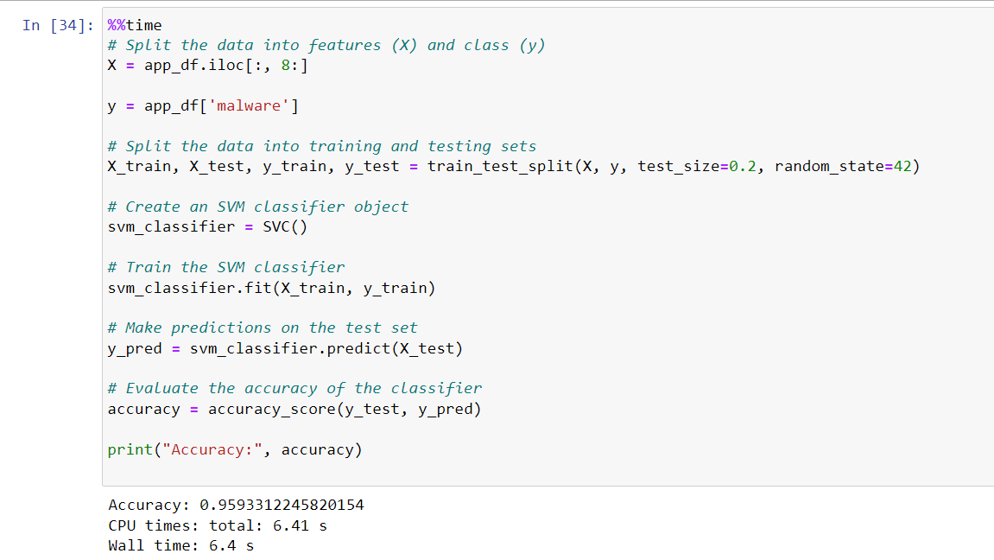

Slide 28
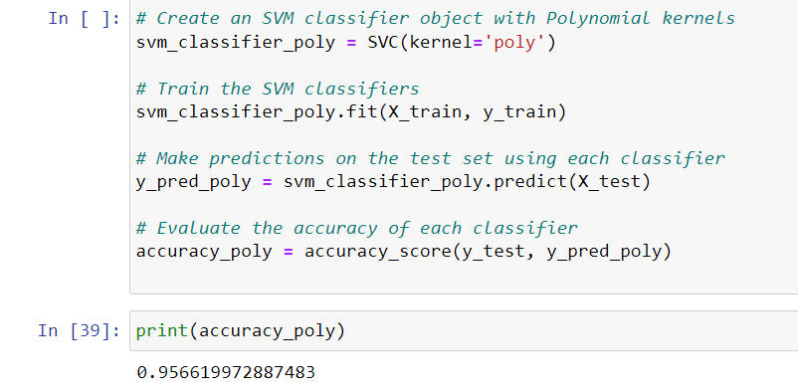
SVM with kernels

Slide 29
Evaluation

Slide 30
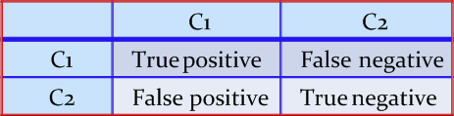
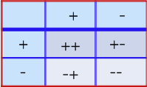
Confusion Matrix
A confusion matrix for a two classes (+, -) is shown below.
There are four quadrants in the confusion matrix, which are symbolized as below.
True Positive (TP: f₊₊) : The number of instances that were positive (+) and correctly classified as positive (+).
False Negative (FN: f₊₋): The number of instances that were positive (+) and incorrectly classified as negative (-).
False Positive (FP: f₋₊): The number of instances that were negative (-) and incorrectly classified as (+).
True Negative (TN: f--): The number of instances that were negative (-) and correctly classified as (-).

Slide 31
Confusion Matrix
Note:
N_{p} = TP (f₊₊) + FN (f₊₋)
= is the total number of positive instances.
N_{n} = FP(f₋₊) + TN(f₋₋)
= is the total number of negative instances.
N = N_{p} + N_{n}
= is the total number of instances.
(TP + TN) denotes the number of correct classifications
(FP + FN) denotes the number of errors in classification.
For a perfect classifier, FP = FN = 0

Slide 32
Confusion Matrix Example
For example,
Calculate the performance evaluation metrics
Class | malware | Benign App
malware | 52 (TP) | 18 (FN)
Benign App | 21 (FP) | 123 (TN)

Slide 33

Accuracy
It is defined as the fraction of the number of examples that are correctly classified by the classifier to the total number of instances.
Accuracy$=\frac{TP+TN}{TP+FP+FN+TN}$

Slide 34
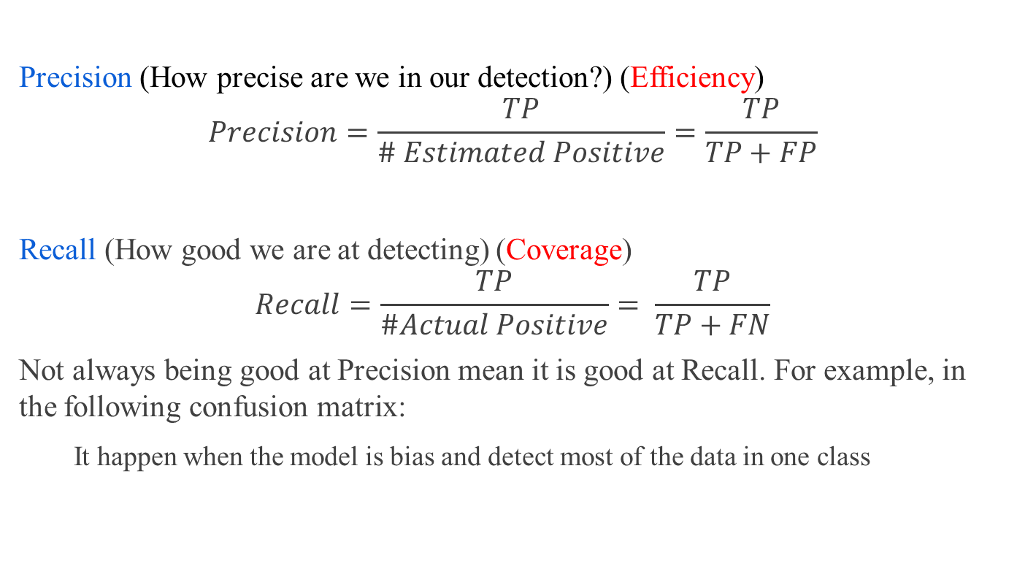
Performance Evaluation Metrics
Precision (How precise are we in our detection?) (Efficiency)
$$Precision=\frac{TP}{\# Estimated Positive}=\frac{TP}{TP+FP}$$
Recall (How good we are at detecting) (Coverage)
$$Recall=\frac{TP}{\#Actual Positive}= \frac{TP}{TP+FN}$$
Not always being good at Precision mean it is good at Recall. For example, in the following confusion matrix:
It happen when the model is bias and detect most of the data in one class
 | malware | Benign
Malware | 10 (TP) | 8(FN)
Benign | 3 (FP) | 10 (TN)

Slide 35
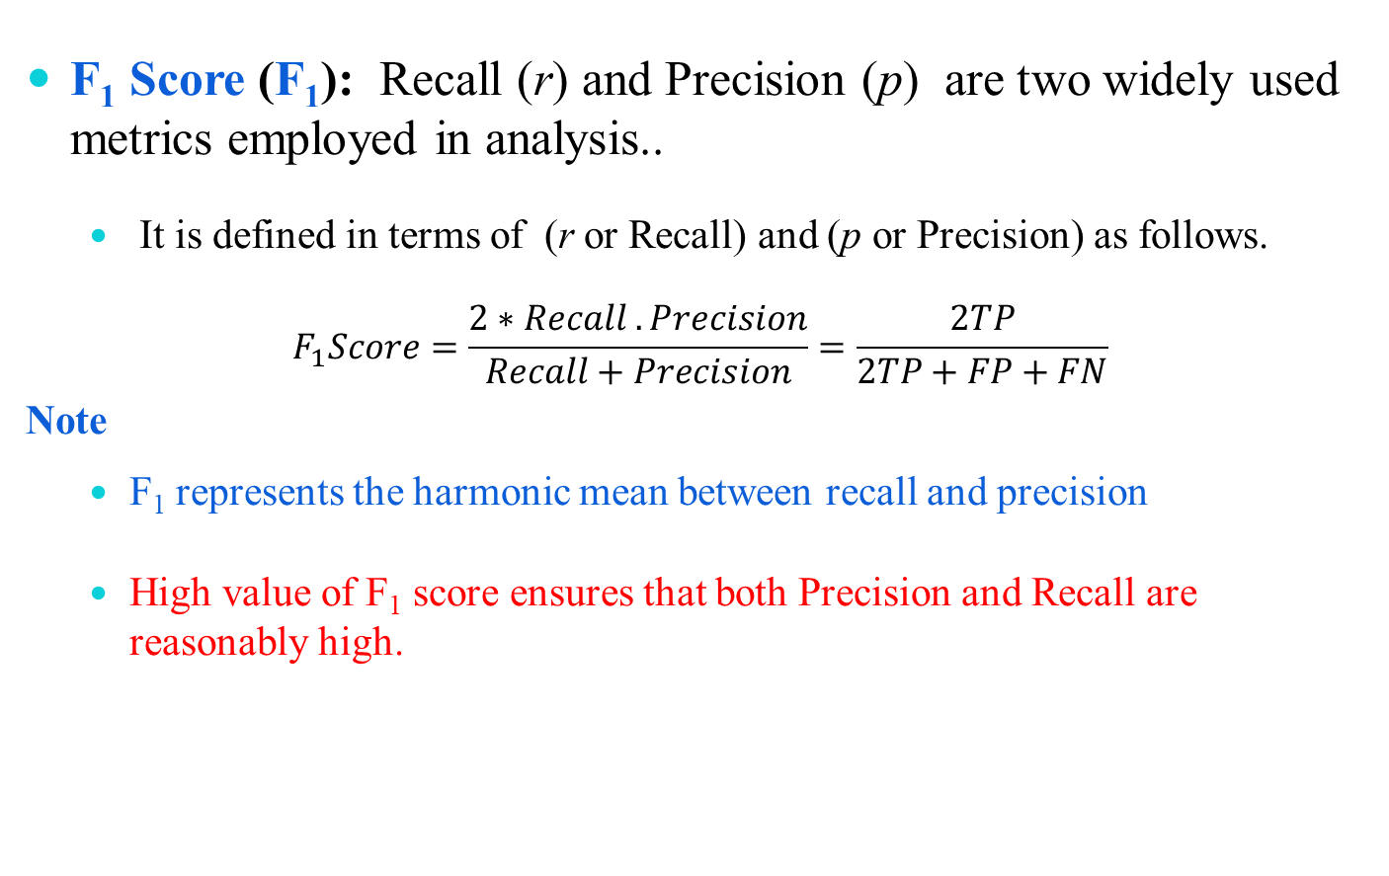
Performance Evaluation Metrics
F₁ Score (F₁): Recall (r) and Precision (p) are two widely used metrics employed in analysis..
It is defined in terms of (r or Recall) and (p or Precision) as follows.
$$F_{1}Score=\frac{2∗Recall .Precision}{Recall+Precision}=\frac{2TP}{2TP+FP+FN}$$
Note
F₁ represents the harmonic mean between recall and precision
High value of F₁ score ensures that both Precision and Recall are reasonably high.

Slide 36
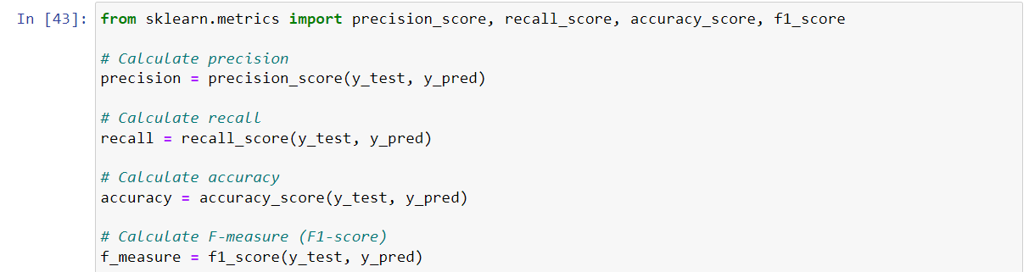

Slide 37
k-Fold cross validation

Slide 38
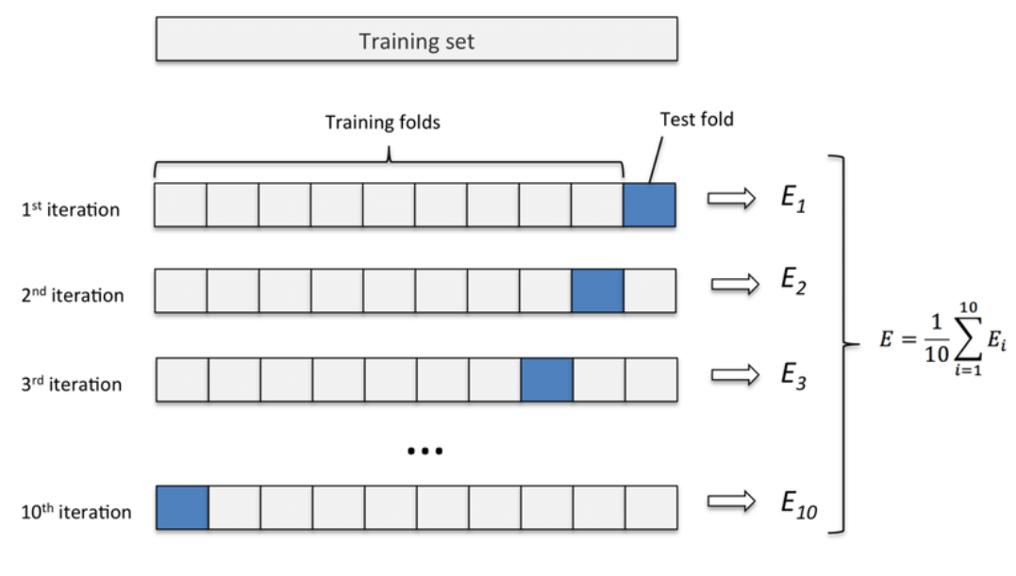
What is 10-fold cross validation

Slide 39
10 fold cross validation with sklearn
from sklearn.model_selection import cross_val_score, train_test_split
# Perform 10-fold cross-validation
scores = cross_val_score(svm_classifier, X, y, cv=10)
# Print the accuracy scores for each fold
print("Accuracy scores for each fold:", scores)
print("Mean accuracy:", np.mean(scores))

Slide 40
